Slide 1

Object-Oriented Programming in Python
Presented by Sourav ,Hemag ,Gopal, Narinder Nikhil

Slide 2


Object-Oriented Programming (OOP) is a way of writing
computer programs using 'objects' and ‘classes’
Classes in OOP (Object-Oriented Programming) in Python are blueprints for creating objects, encapsulating data and functions that operate on that data.
In object-oriented programming (OOP) in Python, an "object" is an instance of a class .
Encapsulation binding data + function (behaviuor ) into classes
2

Slide 3

Zomato’s platform represents essential real-world entities such as Users, Restaurants, Dishes, and Orders as classes. Each class encapsulates relevant attributes (data) and behaviors (methods) to naturally model these entities.
3

Slide 4


OOPS PRINCIPLES
Polymorphism
polymorphism in programming means the ability of function to work in different way
Types of polyporphism
Compile-time polymorphism is when the method to call is decided by the compiler
before the program runs, typically using method overloading.
Run-time polymorphism is when the method to call is decided during program execution
based on the object's type, typically using method overriding.
4

Slide 5
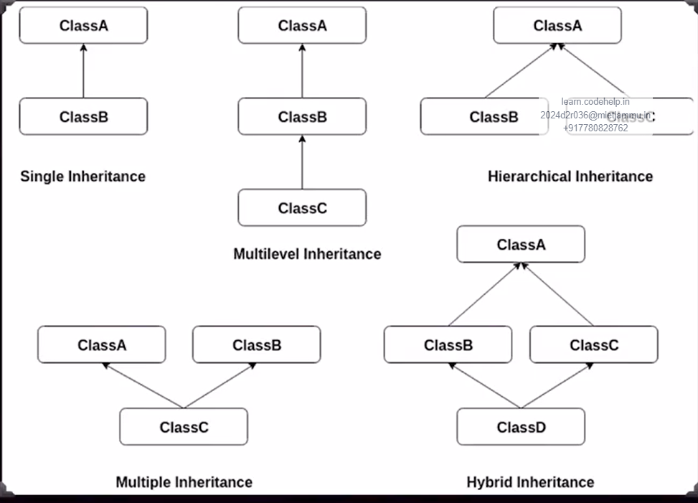
Inheritance
Inheritance in Python means creating a new class that gets the features (attributes and methods) from an existing class, making code reuse easier and helping to build a hierarchy
of classes in simple language.
Single Inheritance: A class inherits from one superclass,
acquiring its properties and methods.
Multilevel Inheritance: A class is derived from a class
which is also derived from another class, forming a chain.
Hierarchical Inheritance: Multiple classes inherit from
a single superclass, sharing its attributes and behaviors.
Multiple Inheritance: A class inherits from more tha
n one superclass, combining features from all.
Hybrid Inheritance: A combination of two or more types
of inheritance, creating a complex hierarchy.

Slide 6
Advantages and Use Cases
Modularity
Code can be reused across projects effectively.
Maintenance
Easier updates and bug fixes improve overall efficiency.
Collaboration
Teamwork is enhanced through shared code structures.
6

Slide 7
Thank you all

